Slide 1



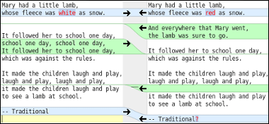

08– Resolving Merge Conflicts
COMP 190 – Dickinson College
Prof. Braught
Fall 2020
Images from:
https://www.atlassian.com/company/news/press-kit
https://github.com/logos
https://meldmerge.org/

Slide 2
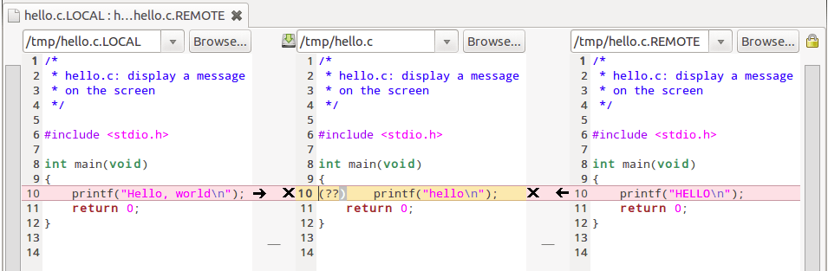
Merge Conflicts
The branching workflow supports distributed collaboration.
Multiple developers working simultaneously…
Local
Merged
Upstream
Images from: https://meldmerge.org/features.html
Notes:
You may be editing a file locally…
Others may have edited and merged their changes into the upstream…
- Changes may be incompatible.
The conflict between them needs to be resolved.
This process is called merging or conflict resolution.
We’ll recap..
Set the stage…
See where these conflicts come from
Then see how resolve them

Slide 3
A Branching Workflow: Pull Request
Notes:
Last time…
Got to the point where you had made a pull request…
- made branch
- stage
- commit
- push to origin
- pull request to upstream
What happens from there…

Slide 4
A Branching Workflow: Upstream Merge
Notes:
When your request is merged,
This is where the activities left off last time.
Your main branch is now out of synch with the upstream.

Slide 5
Synchronizing: Checkout Main & Pull from Upstream
Notes:
So we need to synchronize…
Pull the updated main branch from the upstream.

Slide 6
Synchronizing : Push to Origin
Notes:
Push the update main branch to the origin.
Now your Main branches match those of the upstream
- including your changes.

Slide 7
Synchronizing: Delete Feature Branch
Notes:
Once we’ve done that all of the changes in your feature branch are already in the main branch
So you won’t need to keep the feature branch anymore
- you can if you want, but it is not necessary.

Slide 8
Synchronizing: Push Delete to Origin
Notes:
Need to push that deletion to the origin.
Now everything is in synch and you are ready for more changes.

Slide 9
Collaboration: Simultaneous Work
Notes:
Now you are not the only one working on the upstream.
Others will be working on features and fixes
- and having pull requests merged – blue commit
- Those will update the main branch on the upstream.
You may have created a feature branch
- and be working on it as well.
- Yellow commit.

Slide 10
Collaboration: Synchronize
Notes:
It is your responsibility to make sure your changes are compatible with the upstream main.
Synchronize – same as befoe.
Now you have the other changes (blue commit)
But they need to be combined with your changes (yellow commit)

Slide 11
Collaboration: Merge Main into Feature
Notes:
Need to integrate the other changes into your feature.
- That is make your changes compatible with the new upstream main.
- Do this by merging them into your feature branch.
These may be fine…
- Others changed different files…
- this will be piece of cake – git will handles it easily.
Or these may be in conflict…
- Your changes (yellow)
- conflict with other changes (blue)
- e.g. you changed the same line of code.
You will need to resolve those conflicts.
- as we’ll see on next slides.

Slide 12
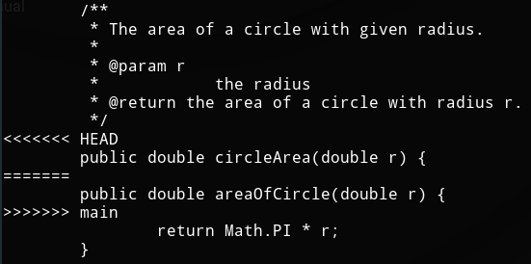
Collaboration: Merge Conflict Resolution

Slide 13
Collaboration: Merge Conflict Resolution
Feature Branch
Merged
Main Branch
https://meldmerge.org/features.html
Notes:
You may have entered “Hello world”
Another develper had “HELLO” merged in the meantime.
You can make the changes compatible
- just hello.

Slide 14
Collaboration: Upstream Merge
Notes:
Project managers will merge into upstream main branch.

Slide 15
Collaboration: Synchronize
Notes:
Synchronize your local and origin main.

Slide 16
Collaboration: Delete Feature Branch
Notes:
Clean up by deleting the feature branch.

Slide 17
What’s Next?
Q07 – Due Friday
A08 – Due 1 week
Revise and resubmits
Be Active on Teams

Slide 18
Acknowledgments:
http://foss2serve.org/index.php/Git:_GitHub_Issues_and_Pull_Request
A similar activity produced by Chris Murphy.
http://foss2serve.org/index.php/Git:_GitHub_Workflow_Activity
A similar activity produced by Darci Burdge and Stoney Jackson.
https://github.com/StoneyJackson/github-workflow-activity/blob/master/presentation.pptx
Slides used by Darci Burdge and Stony Jackson with the above activity.
Basic GitHub elements (cloud/arrows/filesystems) were copied from this slide set.
http://foss2serve.org/index.php/Git:_Working_Locally_from_the_Command_Line
Activity introducing some of the basic git commands produced by Stoney Jackson, Nick Yeates.

Slide 19

Acknowledgments:
Slide Template From:
https://creativecommons.org/licenses/by/4.0/
Slide Content Licensed as:
https://creativecommons.org/licenses/by-nc/4.0/

